Slide 1
Project 1
Sample-HIVE-Project By Gary Larson

Slide 2
SETUP
Optimizations, create database, Create tables, and load data

Slide 3

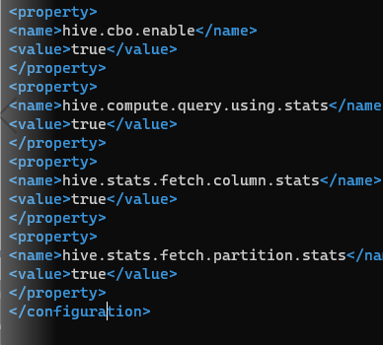
Set Global Configuration
Edited apache-hive-2.3.8-bin/conf/hive-site.xml

Slide 4
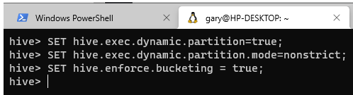
Set Dynamic Partitioning and Enforce Bucketing

Slide 5
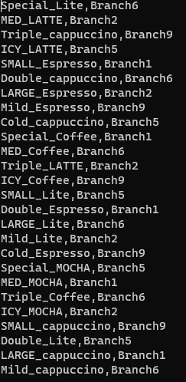
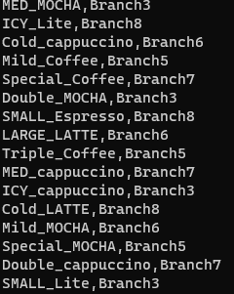
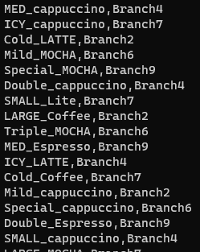
Added Beverage/Branch Files Locally
Bev_BranchA.txt
Bev_BranchB.txt
Bev_BranchC.txt

Slide 6
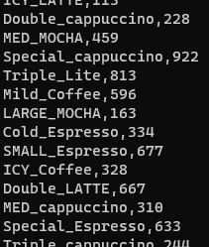
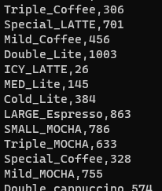
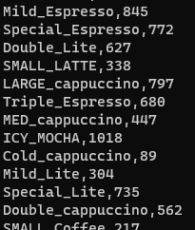
Added Beverage/Cust Count Files Locally
Bev_ConscountA.txt
Bev_ConscountB.txt
Bev_ConscountC.txt

Slide 7
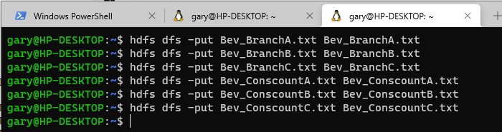
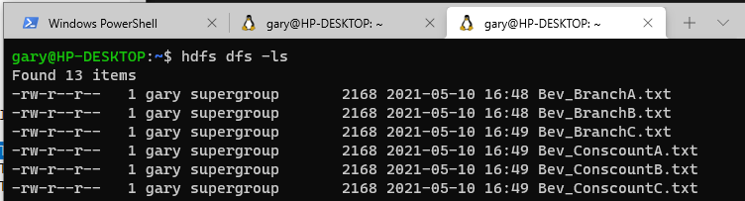
Load and Show Files in HDFS

Slide 8
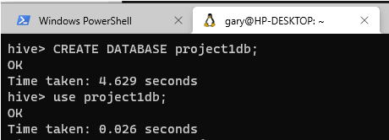
Create and Use Database

Slide 9
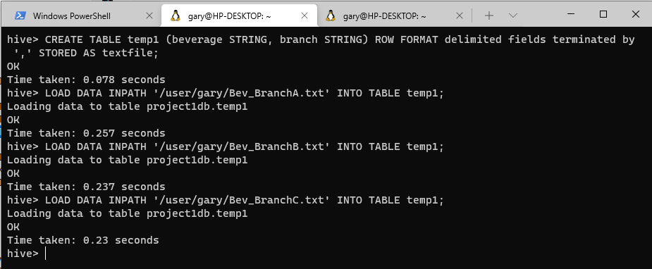
Create Temp1 Table and Load Data

Slide 10
Create and Load beverage_branch
Commands
// create beverage branch table
CREATE TABLE beverage_branch (beverage STRING) PARTITIONED BY (branch STRING) CLUSTERED BY (beverage) into 3 BUCKETS ROW FORMAT delimited fields terminated by ',' STORED AS textfile;
// load data into partitions
INSERT INTO beverage_branch PARTITION(branch)
SELECT beverage, branch FROM temp1;

Slide 11
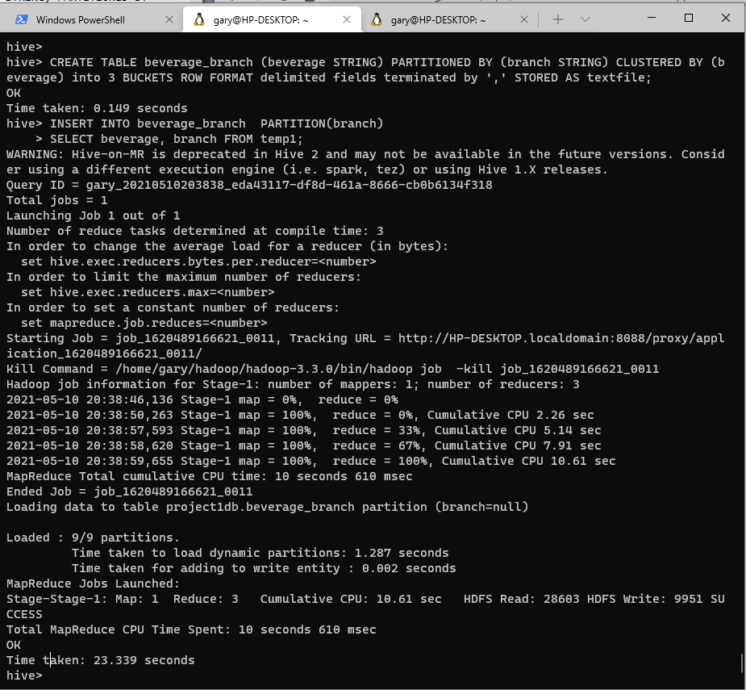
Results: Create Beverage_Branch and Load Data

Slide 12
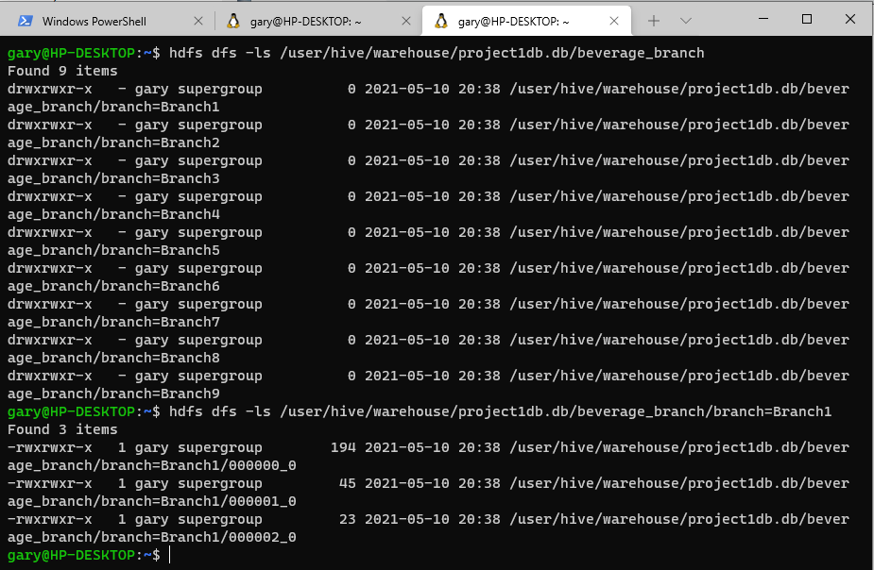
HDFS Partitions and Buckets

Slide 13
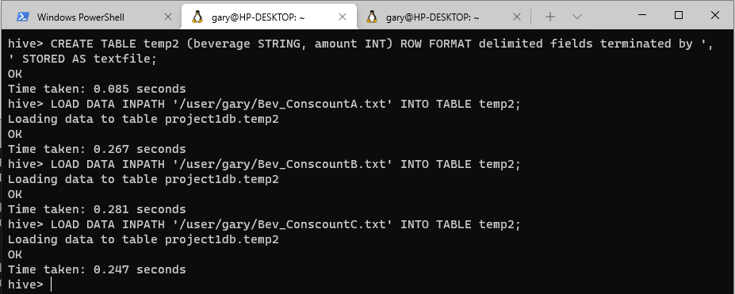
Create Temp2 Table and Load Data

Slide 14
Create and Load beverage_customer
Commands
CREATE TABLE beverage_customer (amount INT) PARTITIONED BY (beverage STRING) CLUSTERED BY (amount) INTO 15 BUCKETS ROW FORMAT delimited fields terminated by ',' STORED AS textfile;
// load data into partitioned table
INSERT INTO beverage_customer PARTITION(beverage)
SELECT amount, beverage FROM temp2;

Slide 15
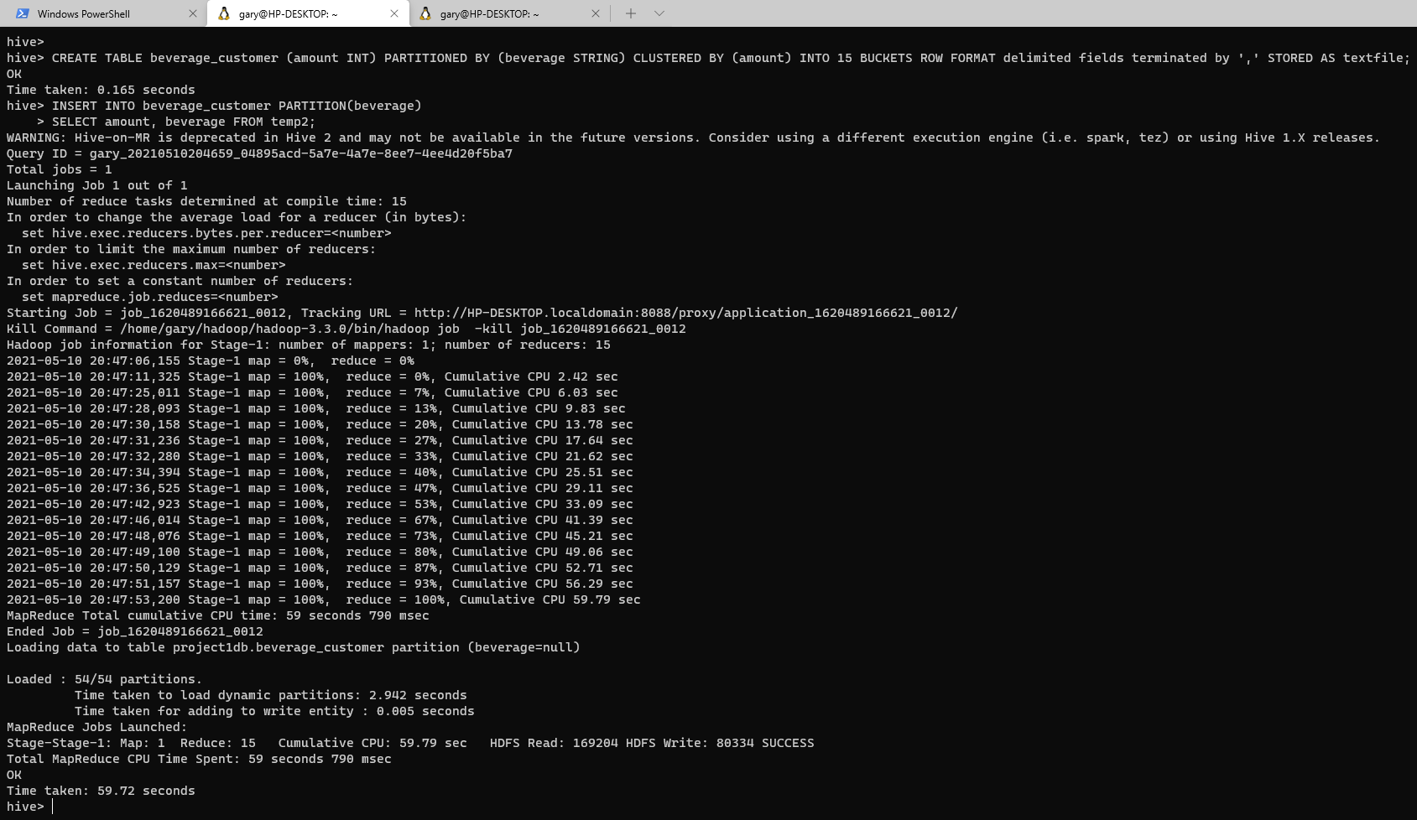
Create beverage_customer and load data

Slide 16
Scenarios
Problem scenarios 1 to 6

Slide 17
Scenario 1
What is the total number of consumers for Branch1?
What is the number of consumers for the Branch2?
SELECT beverage_branch.branch as Branch, SUM(beverage_customer.amount) as Total
FROM beverage_branch JOIN beverage_customer
ON(beverage_customer.beverage = beverage_branch.beverage)
WHERE beverage_branch.branch = 'Branch1' OR beverage_branch.branch = 'Branch2'
GROUP BY beverage_branch.branch
ORDER BY beverage_branch.branch;

Slide 18
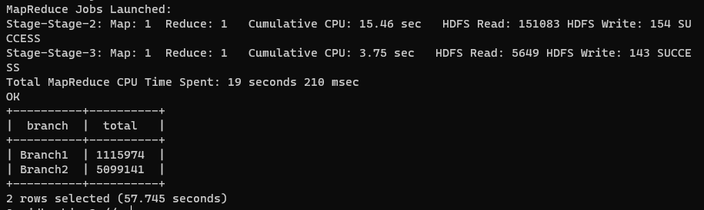
Results: Scenario 1

Slide 19
Scenario 2 Question 1
What is the most consumed beverage on Branch1
SELECT sub.beverage, sub.total FROM (
SELECT beverage_customer.beverage as beverage, SUM(amount) as total FROM beverage_branch JOIN beverage_customer ON(beverage_customer.beverage = beverage_branch.beverage)
WHERE beverage_branch.branch = 'Branch1'
GROUP BY beverage_customer.beverage
ORDER BY total DESC) sub
Limit 1;

Slide 20
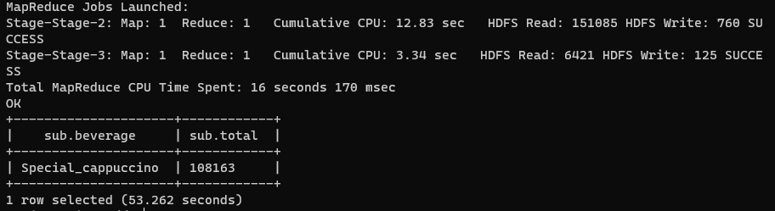
Results: Scenario 2 Question 1

Slide 21
Scenario 2 Question 2
What is the least consumed beverage on Branch2
SELECT sub.beverage, sub.total FROM (
SELECT beverage_customer.beverage as beverage, SUM(amount) as total FROM beverage_branch JOIN beverage_customer ON(beverage_customer.beverage = beverage_branch.beverage)
WHERE beverage_branch.branch = 'Branch2'
GROUP BY beverage_customer.beverage
ORDER BY total ASC) sub
Limit 1;

Slide 22
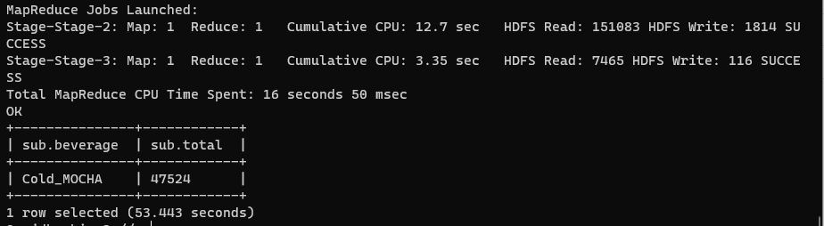
Results: Scenario 2 Question 2

Slide 23
Scenario 3 Question 1
What are the beverages available on Branch10, Branch8, and Branch1?
SELECT Distinct beverage FROM beverage_branch WHERE branch IN ('Branch10', 'Branch8', 'Branch1');

Slide 24
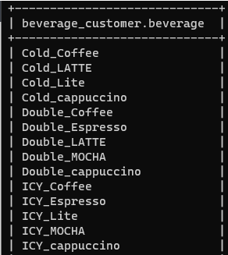
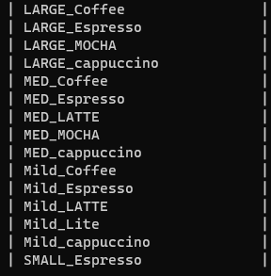
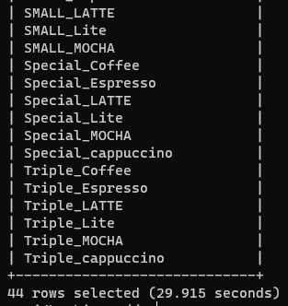
Results: Scenario 3 Question 1

Slide 25
Scenario 3 Question 2
What are the common beverages available in Branch4, Branch7?
SELECT Distinct beverage FROM beverage_branch WHERE branch = 'Branch4'
INTERSECT
SELECT Distinct beverage FROM beverage_branch WHERE branch = 'Branch7';

Slide 26
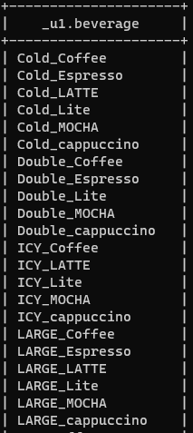
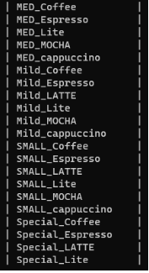
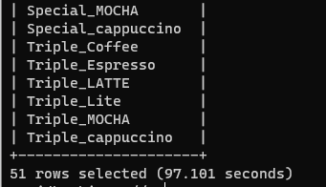
Results: Scenario 3 Question 2

Slide 27
Scenario 4
create a partition, view for the scenario3.
ALTER TABLE beverage_branch ADD IF NOT EXISTS PARTITION (branch='Branch4');
ALTER TABLE beverage_branch ADD IF NOT EXISTS PARTITION (branch='Branch7’);
CREATE VIEW scenario3A_view AS SELECT Distinct beverage FROM beverage_branch WHERE branch IN ('Branch10', 'Branch8', 'Branch1’);
CREATE VIEW scenario3B_view AS SELECT Distinct beverage FROM beverage_branch WHERE branch = 'Branch4'
INTERSECT
SELECT Distinct beverage FROM beverage_branch WHERE branch = 'Branch7';

Slide 28
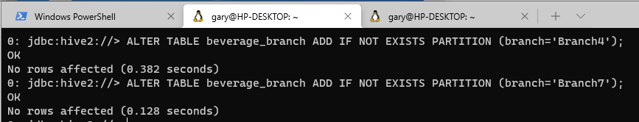
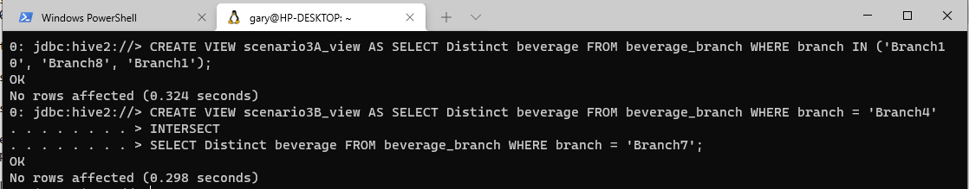
Results: Scenario 4 Partitions - View
Partition
View

Slide 29
Scenario 4
create an index for the scenario3.
CREATE INDEX temp2_index ON TABLE temp2 (beverage) AS "org.apache.hadoop.hive.ql.index.compact.CompactIndexHandler" WITH DEFERRED REBUILD;

Slide 30
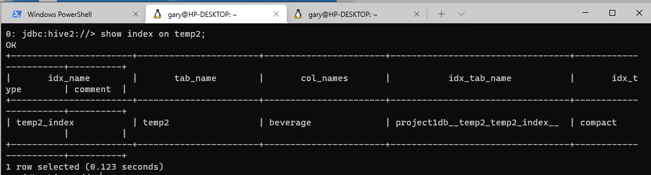
Results: Scenario 4 Index

Slide 31
Scenario 5
Alter the table properties to add "note", "comment".
ALTER TABLE beverage_branch SET TBLPROPERTIES ('note' = "This table has all the beverage branch information", 'comment' = "This is a table from Project 1");
show tblproperties beverage_branch;

Slide 32
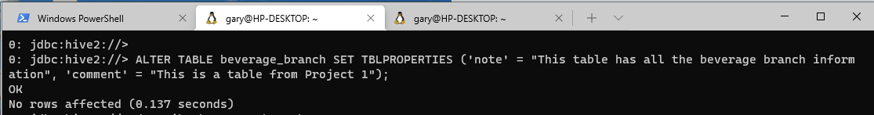
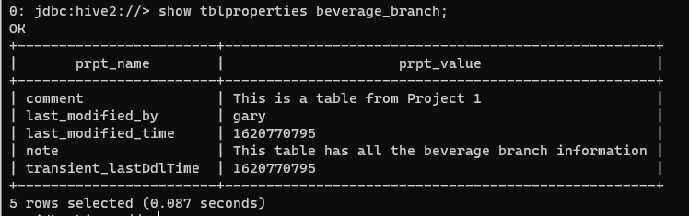
Results: Scenario 5

Slide 33
Scenario 6
Remove the row 5 from the output of Scenario 1
Using Scenario 3
Due to Scenario 1 only having two rows I am using Scenario 3 Question 1
SELECT beverage FROM
(
SELECT beverage, ROW_NUMBER() OVER (ORDER BY beverage) as rank FROM
(
SELECT DISTINCT beverage FROM beverage_branch WHERE branch IN ('Branch10', 'Branch8', 'Branch1')
) result
) result1
WHERE rank != 5;

Slide 34
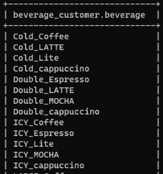
Results: Scenario 6
Scenario 3 Question 1
Scenario 6

